Slide 1



Nurse Licensure Compact
Rhode Island House of Representatives Study Commission
March 7, 2023

Slide 2

Nurse Licensure Compact
What is the Nurse Licensure Compact?
The Nurse Licensure Compact (NLC) allows a nurse to have one multistate license with the ability to practice in their home state and other compact states.

Slide 3

Nurse Licensure Compact
What is the difference between contract labor and compact licensure?
The Nurse Licensure Compact does not encourage or assume use of contract/ travel RNs.
Contract labor involves the temporary use of travel RNs.
Contract labor is used as a last resort to fill vacancies, lessen critical needs, and maintain access to health care services.
The Nurse Licensure Compact allows greater mobility for nurses, including agency nurses or contract labor, and therefore more timely access to workforce.

Slide 4
What are the Benefits of NLC?
Telenursing
Nurses in eNLC states with multistate licenses are able to practice telenursing in all eNLC states.
Disaster Response
Allowing nurses to quickly cross state borders and provide vital services in the event of a disaster.
Online Nursing Education
Nurse educators in eNLC states with multistate licenses are able to teach via distance education in all eNLC states.
Workforce Mobility
Making practicing across state borders affordable and convenient.
Military Families
Efficiency
Allows military spouse nurses to seamlessly continue working without having to obtain a new license each time they relocate.
Eliminates redundancy, duplicative regulatory processes and unnecessary fees.

Slide 5
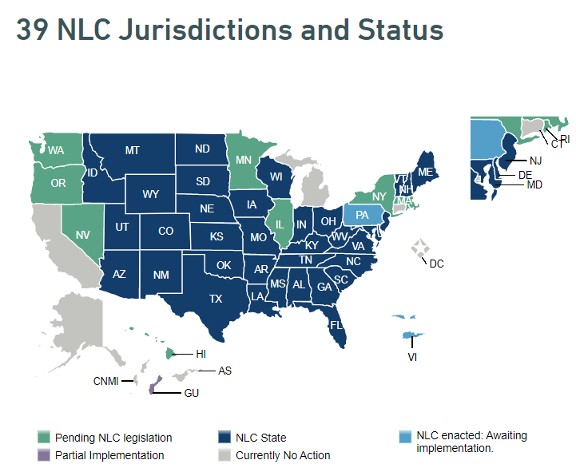
Where is the Nurse Licensure Compact Enacted?

Slide 6


The Driver’s License Comparison
Driver’s License Compact
Issued in your primary state of residence
When driving in other states, you must know and obey that state’s laws (rules of the road)
While driving in other states, if you violate the state’s law, the state can remove your driving privileges in that state.
When you change your primary state of residence (move), you need to apply to that State’s driver's license. You can drive on your former license for a certain number of days. The former license then becomes invalid.
While driving in other states, if you violate the state’s laws and the state takes disciplinary action, it is reported to the state that issued your license (where you reside). Most home states can take the same action as if you committed the violation in your home state.
Nurse License Compact
Issued in your primary state of residence
When practicing other states you must know and obey that state’s laws (Nurse Practice Act)
While practicing in other states, if you violate the state’s laws, the state can remove your practice privileges in that state.
When your change your primary state of residence (move) to another compact state, you need to apply for that state’s nursing license. You should apply immediately as there is no grace period. You can only practice on your former multistate license until you are issued your new multistate license from your new PSOR. The former license then becomes invalid.
While driving in other states, if you violate the state’s laws and the state takes disciplinary action, it is reported to the state that issued your license (where you reside). Most home states can take the same action as if you committed the violation in your home state.

Slide 7

Uniform Licensure Requirements
Meets requirements for licensure in home state (PSOR)
a. Has graduated from a board-approved education program; OR
  b. Has graduated from an international education program
Has passed English proficiency exam (as applicable)
Has passed an NCLEX or predecessor exam
Is eligible for or holds an active, unencumbered license (i.e., without active discipline
Has submitted to state and federal fingerprint-based background checks
Has not been convicted or found guilty, or has entered into an agreed disposition, of a felony offense under applicable state or federal crime law
Has no misdemeanor convictions related to the practice of nursing
Is not currently a participant in an alternative program
Is required to self-disclose current participation in an alterative program
Has a valid US Social Security Number

Slide 8

Investigations & Reciprocal Actions
Sharing information between party states improves efficiency while encouraging a party state’s responsibility to protect the publics’ health and safety.
A party state demonstrates cooperation with the Compact by facilitating the exchange of information between party states in the areas of nurse regulation, investigation and adverse actions.
A state BON has the authority to take action against a licensee on the basis of another state’s licensure disciplinary action that implicates the individual’s ongoing ability and likelihood to practice professionally and safely. This retained jurisdictional authority, allowed by administrative law principles and case law, seeks to prevent the nurse from evading disciplinary action merely by fleeing the state.

Slide 9
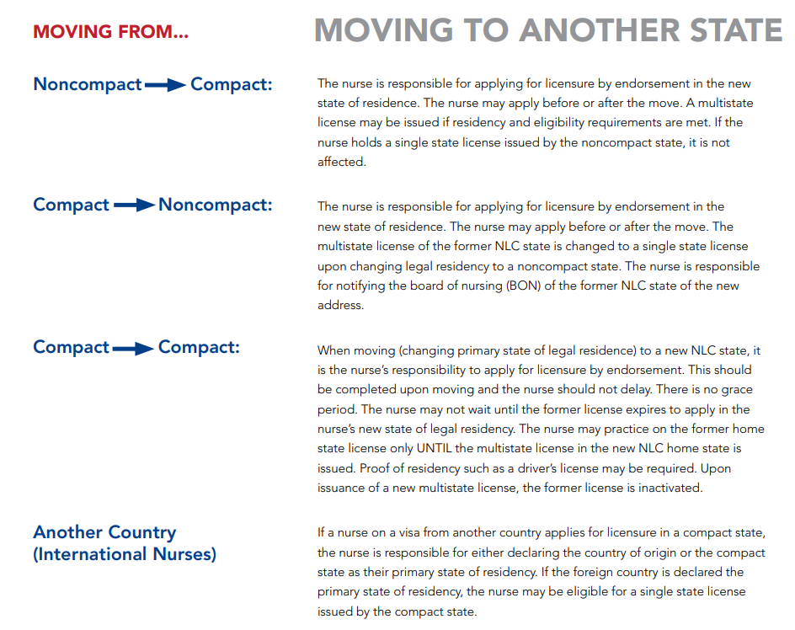

What happens when nurses move from one state to another?

Slide 10
Why Should RI Join the NLC?
The current system limits mobility of nurses and access to care for patients
Nurse educators that teach online students across the country need to hold multiple licenses
Delayed health care responses to natural disasters and other emergencies
Traditional licensure imposes unnecessary burden on military families

Slide 11
APPENDIX

Slide 12

Current Nursing Workforce in RI
RIBON/ Licensing Unit Data- Primary State of Residence
Total Active RN/ LPN in RI | 32,887
Home Address in RI | 17,492
License Address in RI | 15,808
RIBON/ Licensing Unit Data- Endorsement vs. Examination
Examination | 15,765
Endorsement | 16,925
Foreign | 5
Military- Examination | 36
Military- Endorsement | 156

Slide 13
NLC Supporters
Air & Surface Transport Nurses Association
AlediumHR
Alliance for Connected Care
American Academy of Ambulatory Care Nursing
American Association of Colleges of Nursing
American Association of Neuroscience Nurses
American Association of Occupational Health Nurses (AAOHN)
American Association of Poison Control Centers
American Nephrology Nurses Association
American Organization for Nursing Leadership (AONL)
American Red Cross
American Telemedicine Association (ATA)
Asian American/Pacific Islander Nurses Association
Association of Camp Nursing
Association for Vascular Access
Case Management Society of America (CMSA)
CGFNS International, Inc.
CHG Medical Staffing, Inc. dba RN Network
Citizen Advocacy Center (CAC)
Commission for Case Manager Certification
Cross Country Healthcare
CTel Innovations
Emergency Nurses Association (ENA)
Health Innovation Alliance
Hospital Corporation of America (HCA) Healthcare
Institute for Healthcare Improvement (IHI)
National Association of Travel Healthcare Organizations (NATHO)
National Military Family Association
National Military Family Association
National Governors Association Center for Best Practices
National League for Nursing
National Patient Safety Foundation
National Student Nurses’ Association (NSNA)
Oncology Nursing Society
Optum
Organization for Associate Degree Nursing
Population Health Alliance
Telehealth Leadership Council
U.S. Department of Commerce
WorldWide HealthStaff Solutions Ltd.

Slide 14
First Time NCLEX Test Takers: Local Market Intel
Year | 1st Time US-Educated Taking NCLEX for U.S. Licensure, by Degree type (RI only) |  |  | Total # of 1st Time NCLEX Candidates who Passed in RI | 1st Time NCLEX Pass Rates in RI
 | DIP | ASN | BSN
2018 | 64 | 223 | 330 | 617 | 89.6%
2019 | 26 | 294 | 346 | 666 | 88.9%
2020 | 0 | 335 | 347 | 682 | 87.8%
2021 | 0 | 264 | 323 | 587 | 85.4%
2022 | Data Not Yet Available from NCSBN

